Slide 1


Microsoft Movie Studio Recommendations
Make movies for the world. Maximize value. Minimize risk.

Slide 2

Overview
Microsoft is standing up a new movie studio and needs business insights.
EMG Consulting has been retained to issue recommendations.

Slide 3

Our Approach
Using data from The Numbers and IMDB, we created a dataset of over 1,200 movies released between 2012 and 2019. This dataset was of particular interest because it begins with the year that Netflix released its first Original production, and ends the year before the COVID-19 pandemic upended the movie industry. For each movie, we created visualizations and recommendations based on the following information:
Production budget
Domestic, international, and worldwide gross and profit
Genre(s)
Director

Slide 4
Recommendation #1: Market films internationally to maximize the value of your production dollar.
“There’s still a 1950s view of cinema, that there’s one audience and they all want to see the same thing.”
Michael Winterbottom, Palme d’Or-nominated director

Slide 5
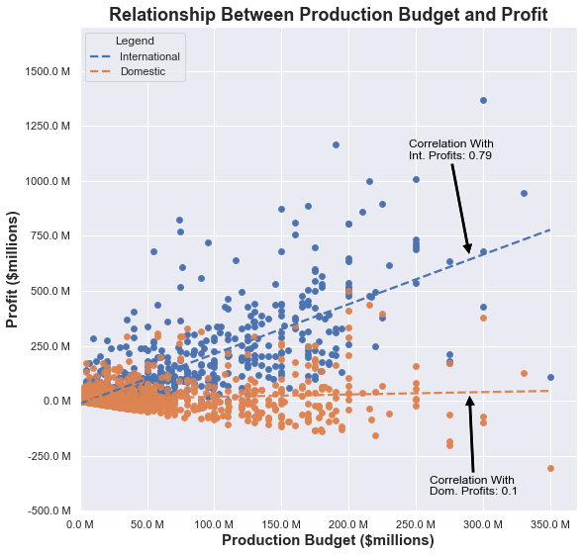
Production dollars earn a better return at the international box office.
Strong positive correlation between production budget and international profit
Nearly no correlation with domestic profit.
Studios earned higher profits internationally than they did domestically.

Slide 6
Recommendation #2: Focus on making movies that include a mix of characteristics from the Sci-Fi, Animation, and/or Thriller genres.
“If studios don’t get their money back, we don’t have any movies.”
Ridley Scott, Oscar-nominated director

Slide 7
Delivering Big Profits at a Good Value.
Profit
How much can we make?
Profit Ratio
Is it a good value for us?
Rank
How does it compare?
Average amount earned by a movie of a particular genre.
Profit divided by average production cost.
Comparison of Profit and Profit Ratio across genres.
Notes:
Earning the highest possible overall profit is a key factor for Microsoft to consider in standing up its new enterprise, but the company does not have an infinite budget to do so. The Microsoft movie studio will have to ensure it is investing wisely to maximize the value of each dollar it invests.

Slide 8
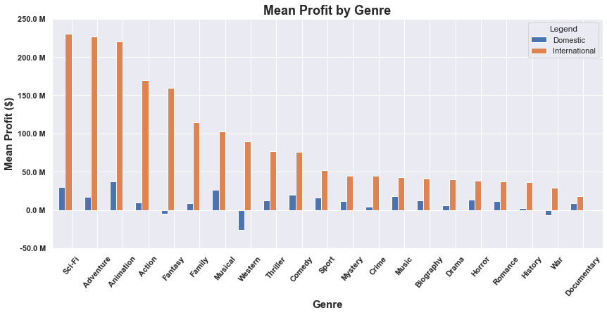
Profit
Notes:
Earning the highest possible overall profit is a key factor for Microsoft to consider in standing up its new enterprise, but the company does not have an infinite budget to do so. The Microsoft movie studio will have to ensure it is investing wisely to maximize the value of each dollar it invests.

Slide 9
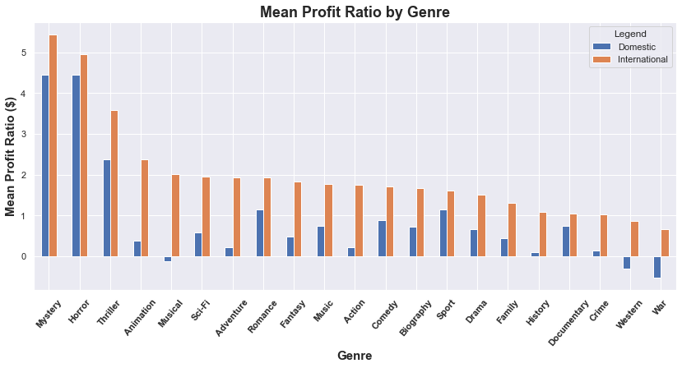
Profit Ratio
Notes:
Earning the highest possible overall profit is a key factor for Microsoft to consider in standing up its new enterprise, but the company does not have an infinite budget to do so. The Microsoft movie studio will have to ensure it is investing wisely to maximize the value of each dollar it invests.

Slide 10
Ranking genres by mean profit and mean profit ratio allows us to identify what types of films deliver the right combination of value and overall return.
Genre | Overall Ranking
Sci-Fi | 1
Animation | 2
Thriller | 3
Mystery | 4
Horror | 5
Adventure | 6
Comedy | 7
Musical | 8
Sport | 9
Music | 10

Slide 11
Recommendation #3: To mitigate risk, avoid high-budget action films and money-losing directors.
“I don’t try to guess what a million people will like. It’s hard enough to know what I like.”
John Huston, Oscar-winning director

Slide 12


Clunkers.
01 | Dark Phoenix: $200 million loss
02 | MIB International: $106 million loss

Slide 13
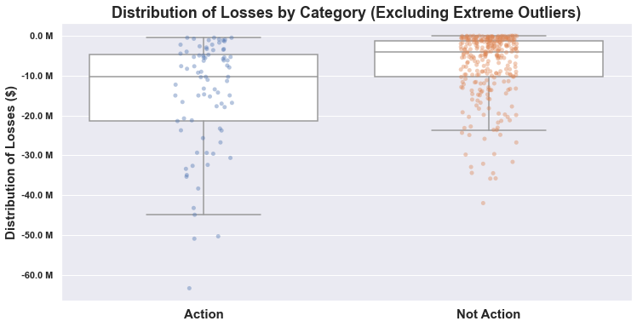
When Action Movies Lose, They Lose Big.
$4,148,310
$10,319,750

Slide 14
Some directors are diamonds in the rough. Some are just rough.
Factor in whether a director has a track record of major clunkers (films that lost $1 million or more) when selecting people to lead its projects.
Director | Major Clunkers
David Gordon Green | 3
Simon West | 2
Kevin Smith | 2
Justin Chadwick | 2
James Gray | 2
Mira Nair | 2
Jacques Audiard | 2
David Koepp | 2

Slide 15
Thank you.
“I don’t want to tell you how to do your job, but somebody has to.”
- David Fincher, Oscar-nominated director
Contact:
emgerber94@gmail.com GitHub Repository Link

